Slide 1
Software development steps

Slide 2
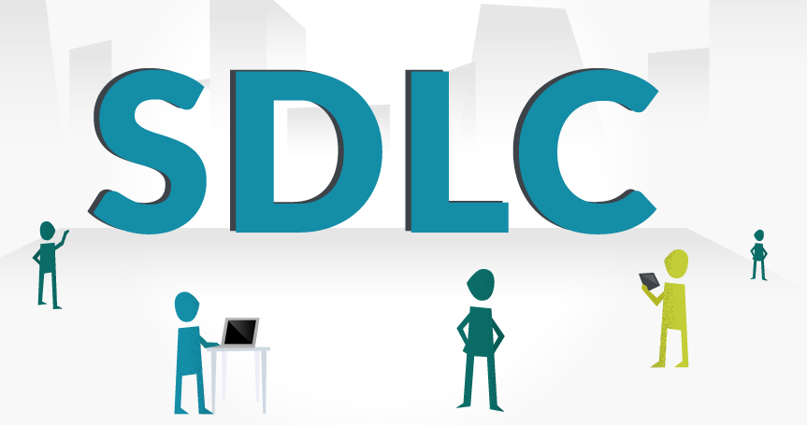

the time between the product is initially designed and finally released
—

Slide 3


Software development is a complicated process. Usually, it consists of a certain number of phases.

Slide 4
We will be talking about 7 main stages of software development:
1. Brainstorming
2. Feasibility Analysis
3. Desing
4. Programming
5. Integration
6. Quality analysis
7. Release

Slide 5

Phase 1 – Brainstorming

Slide 6


Coming up with innovative ideas is often challenging
Recent years have already brought us so many brand new IT products and technological innovations

Slide 7

product and project managers together with developers have to think globally

Slide 8


A technique of brainstorming is effective in IT environment. It is as a creative method to find out the best solutions and ideas appropriate for implementing during the SDLC.

Slide 9



All members of the brainstorming process contribute their ideas and offer them during the discussion.

Slide 10


generates the main requirements to the projects as well as creates a general roadmap

Slide 11



Planning influences the whole development process and the ways everything will be done.

Slide 12

Phase 2 – Feasibility Analysis

Slide 13


CEO and all team members have to carry out a feasibility analysis

Slide 14


The feasibility study can show how successful a project could be, evaluates all factors.

Slide 15



Every member of the team, testers, developers, PMs, and others, must provide a clear estimate of time they need to complete their specific tasks, efforts and resources they need to involve.

Slide 16

Phase 3 – Design

Slide 17
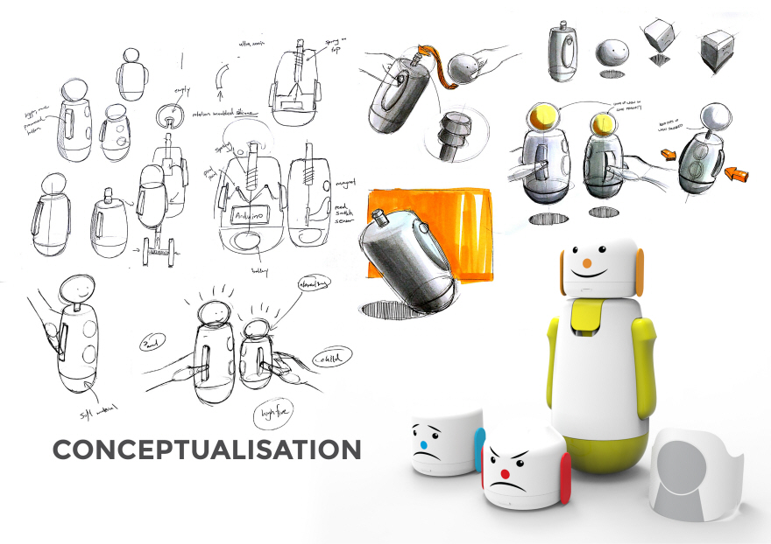


Conceptualizing the product is made on design stage of SDLC. Design is developed according to the specifications

Slide 18



Designers, like any other architects, build the whole structure of the project and provide the final prototype that will be used for the next stages of development process.

Slide 19

Phase 4 – Programming

Slide 20



Here is coding where developers are getting started.

Slide 21

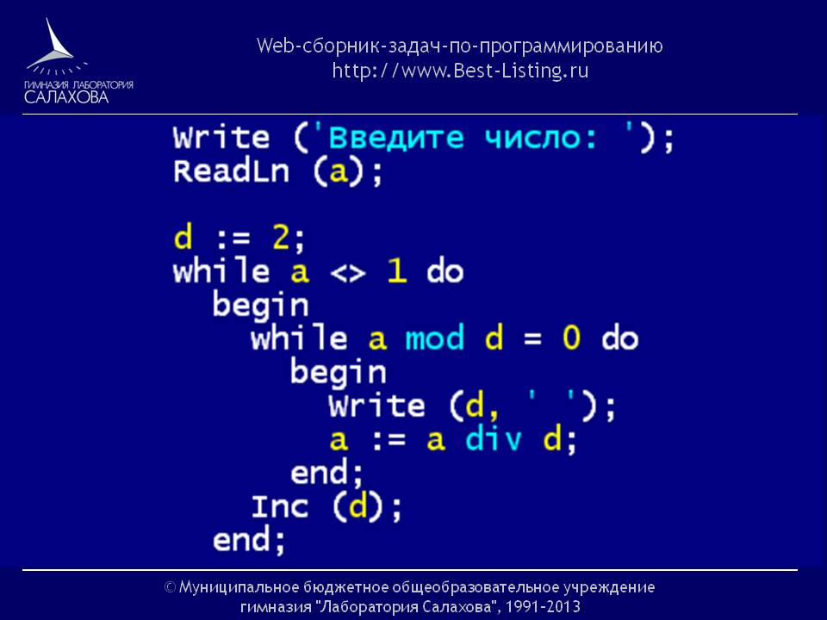

Every programmer has his own task for coding for which he is responsible.

Slide 22


The process of programming is controlled by project managers. This phase is the most time-consuming operation.

Slide 23

Phase 5 – Integration

Slide 24


Integrating of all sources and environments is a must in software development as it helps to figure out on time how many issues, conflicts, and bugs are there.

Slide 25


Most teams, especially agile ones, use continuous integration. Such teams execute unit tests, use automated compilation and tests.

Slide 26

Phase 6 – Quality analysis

Slide 27
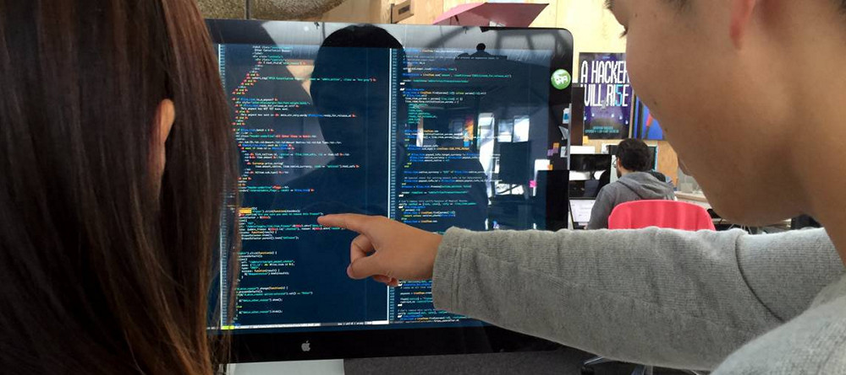
QA engineers test the quality of the code written by developers.

Slide 28




They use different frameworks and kinds of testing to discover if there are any bugs in the system

Slide 29


Testers write test cases and report the bugs to developers to fix them.

Slide 30

Phase 7 – Release

Slide 31


First software release will be followed by the releases of next versions of the product.

Slide 32



It is the final stage of development that can be also followed by maintenance and support.

Slide 33


Each of the stages of SDLC life cycle depends on the model of software development a company chooses.

